Slide 1
Mall customers segmentation
Mini Project 3
Submitted by:
Sumit

Slide 2
Introduction
Customers who come for shopping in a mall can be grouped in a number of ways. Shopping pattern, spending pattern, shopping score, salary etc. are some of the factors that can be used to divide the customers into different categories.
The reason for these clusters is to help identify those customers who would be interested in certain products, offers and services.
The store may strategize its offerings in such a way that it targets only right customers for specific products.
This helps in creating a win-win situation for both the store (in terms of revenue and more customers through customer recommendation) and the customer (discounts, offers, reward points, gifts, etc).

Slide 3
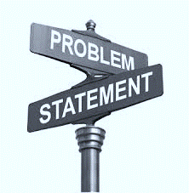
Problem statement
The main purpose of performing customer segmentation is to group people, who have similar interest so that the marketing team can converge in an effective marketing plan.
In order to achieve this goal, a predictive model can be built to find out the group of customers and find out the right customers for specific products.
What are the key factors that can help mall to increase the sales and profit.

Slide 4
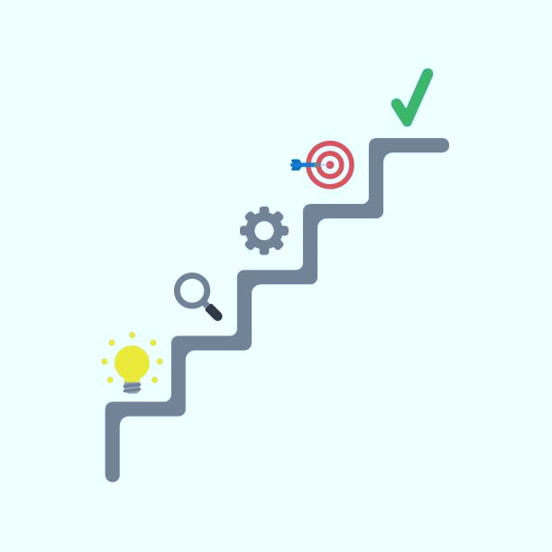
Methodology
Read the data.
Summarize the data.
Data structure (Type of data).
Data Visualization.
Data preprocessing
Selecting right algorithm for model building.

Slide 5
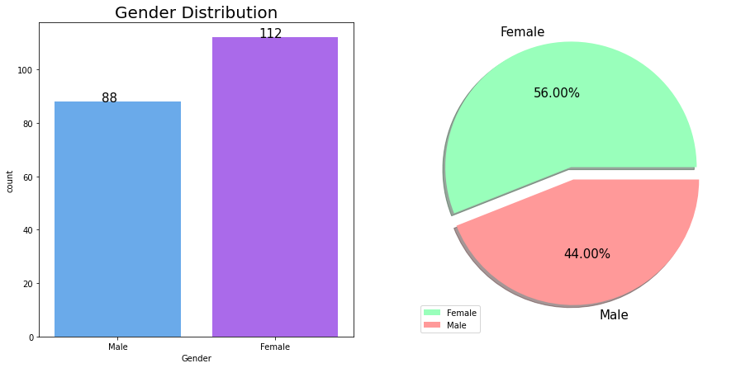
Eda(Exploratory data analysis)
Here 56 % of gender belong to Female category and 44 % belong to Male category it means female customer visits more as that of male.

Slide 6
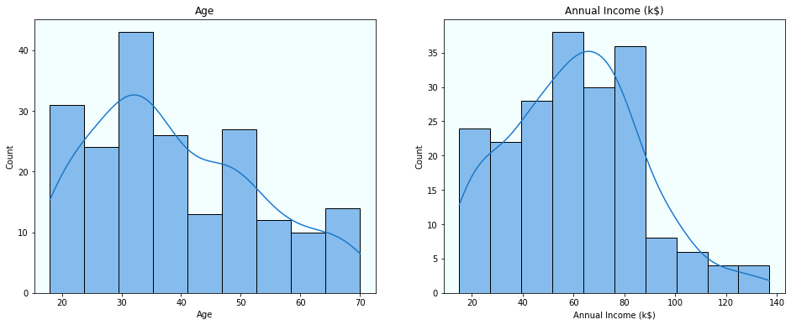
Distribution of age and annual income
Maximum customers are age between 30-35.
Maximum income lies between 50-65.

Slide 7
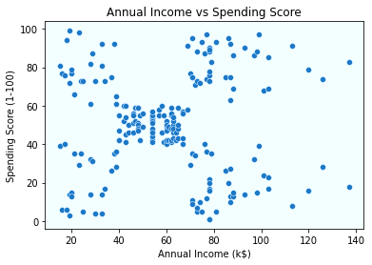
Annual income vs spending score

Slide 8
Model used(Clustering)
K –Mean
Hierarchical Cluster
DBSCAN

Slide 9
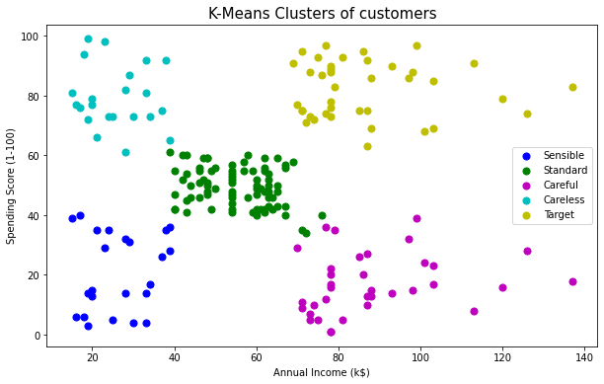
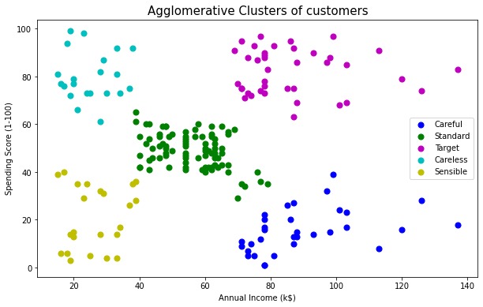
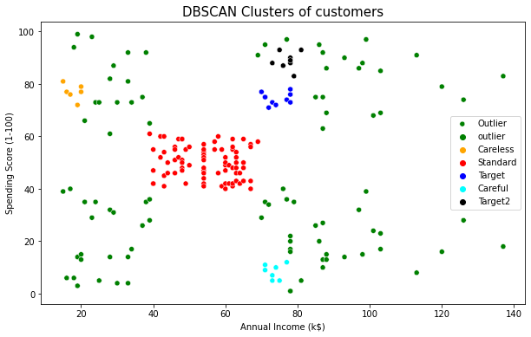
Results

Slide 10
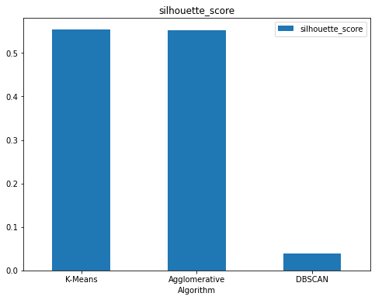
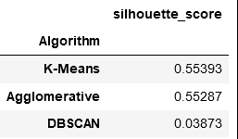
Results

Slide 11
Results
In Target cluster people have high income and high spending scores, these people might be the regular customers of the mall and are convinced by the mall’s services.
In careful cluster people are careful which have high income but low spending scores, Maybe these are the people who are unsatisfied by the mall’s services. So, we can target these customers because they have the capability to spend more. So, the mall authorities will try to add new facilities so that they can attract these people and can meet their needs.
In standard cluster people have average income and an average spending score, these are the average peoples again they will be considered and give some offers to increase their spending score.

Slide 12
results
In careless cluster people have low income and high spending scores these people might be the regular customers of the mall and are convinced by the mall’s services.
In sensible cluster people have low annual income and low spending scores, people having low salaries prefer to buy less, The mall will be least interested in people belonging to this cluster.

Slide 13
Conclusion
By comparing all the models with silhouette score we find that Agglomerative Clustering Algorithm is best model which give better predictions. So, we consider Agglomerative Clustering Algorithm as the best model for this dataset.
By considering all the conditions, we can target standard cluster, target cluster and careful cluster customers because they have the capability to spend more. So , mall facilities can focus on these customers by giving some extra offers and discounts.

Slide 14


